Slide 1
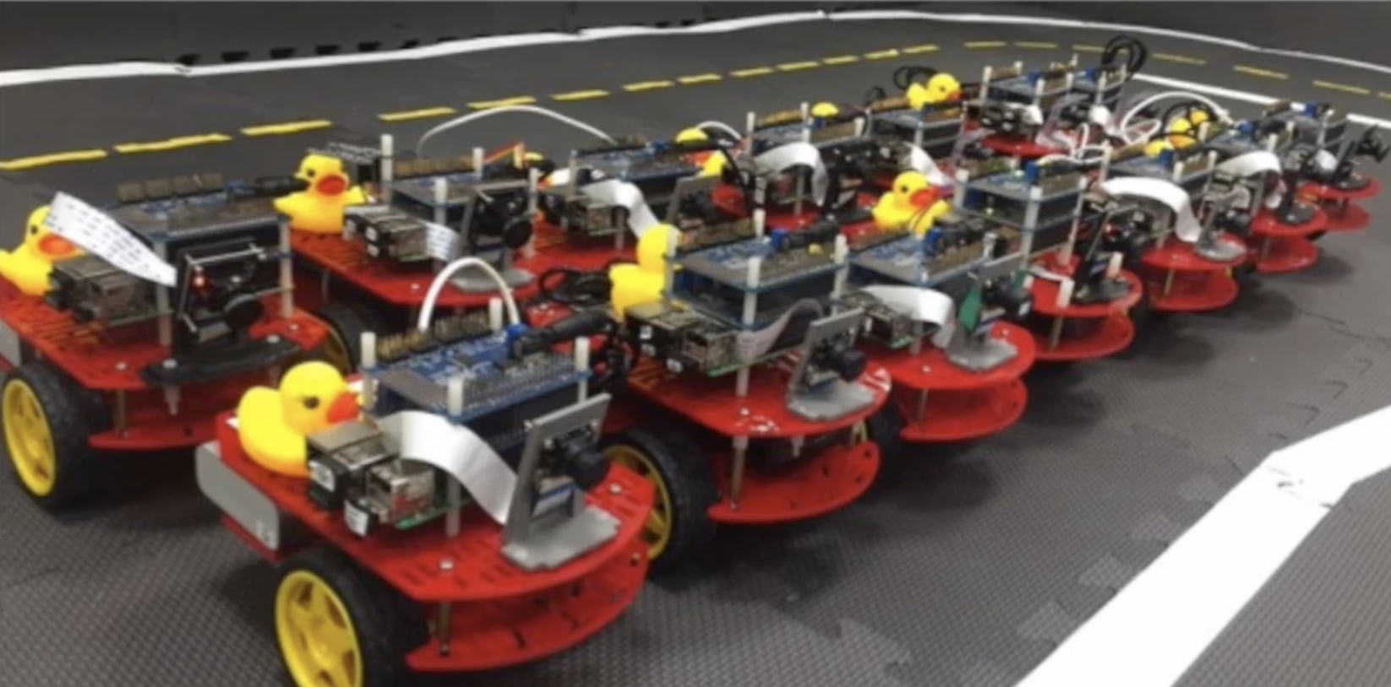
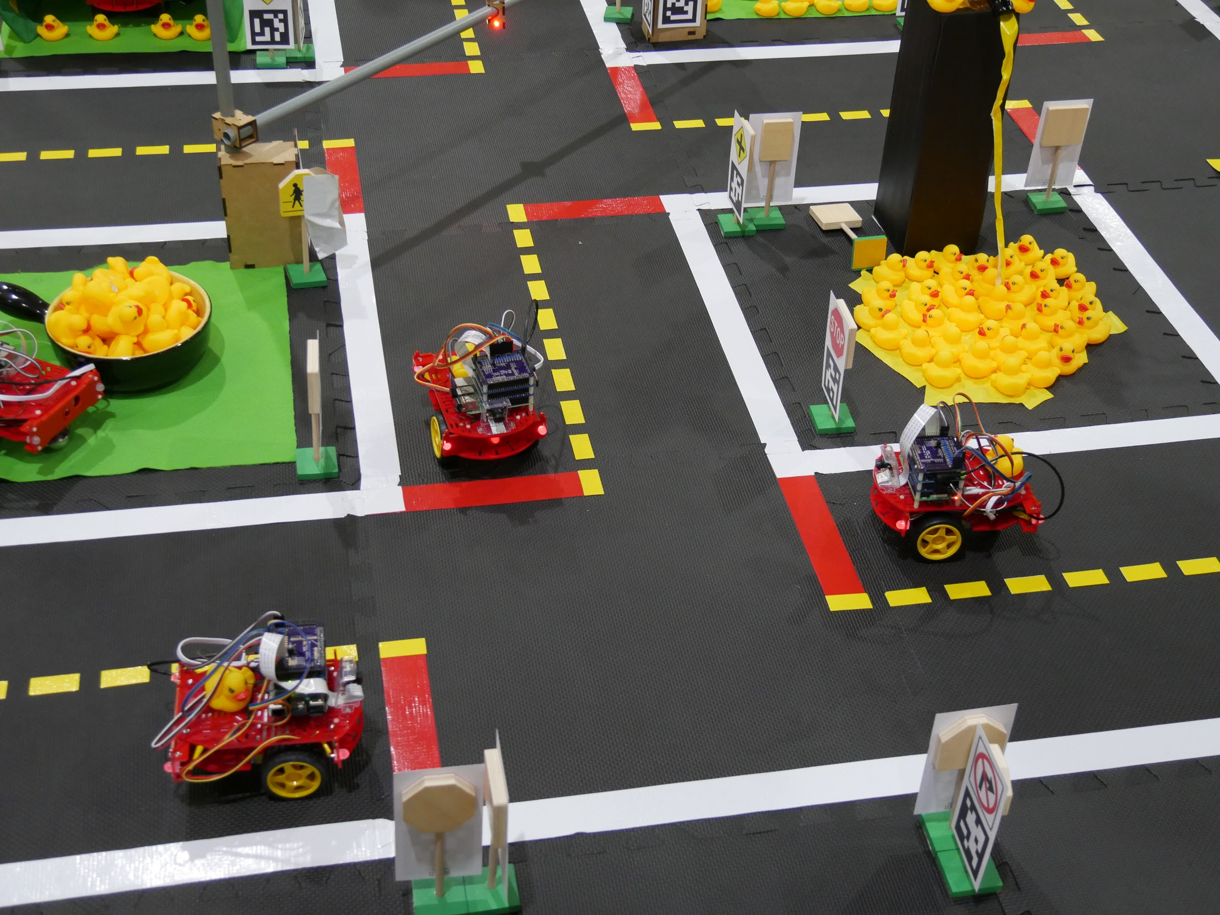
Welcome
to CS 3630!
Spring 2021:
Flipped class!
New projects!
A new course outline!

Slide 2
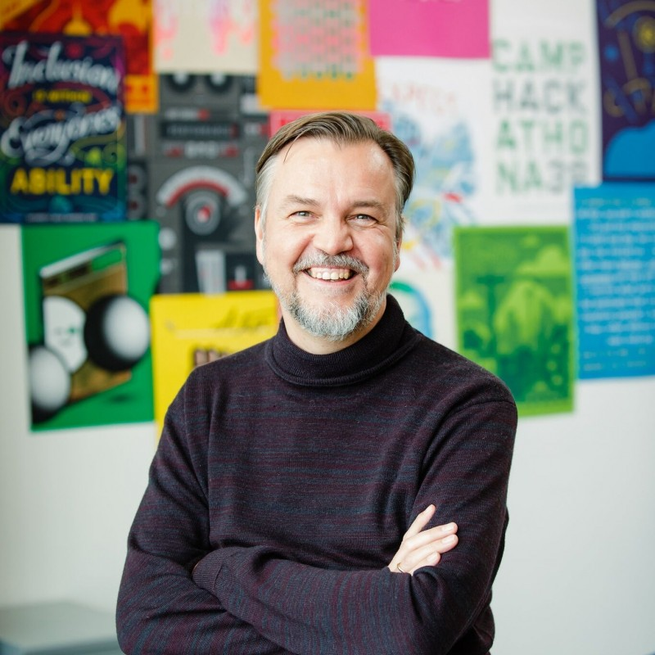
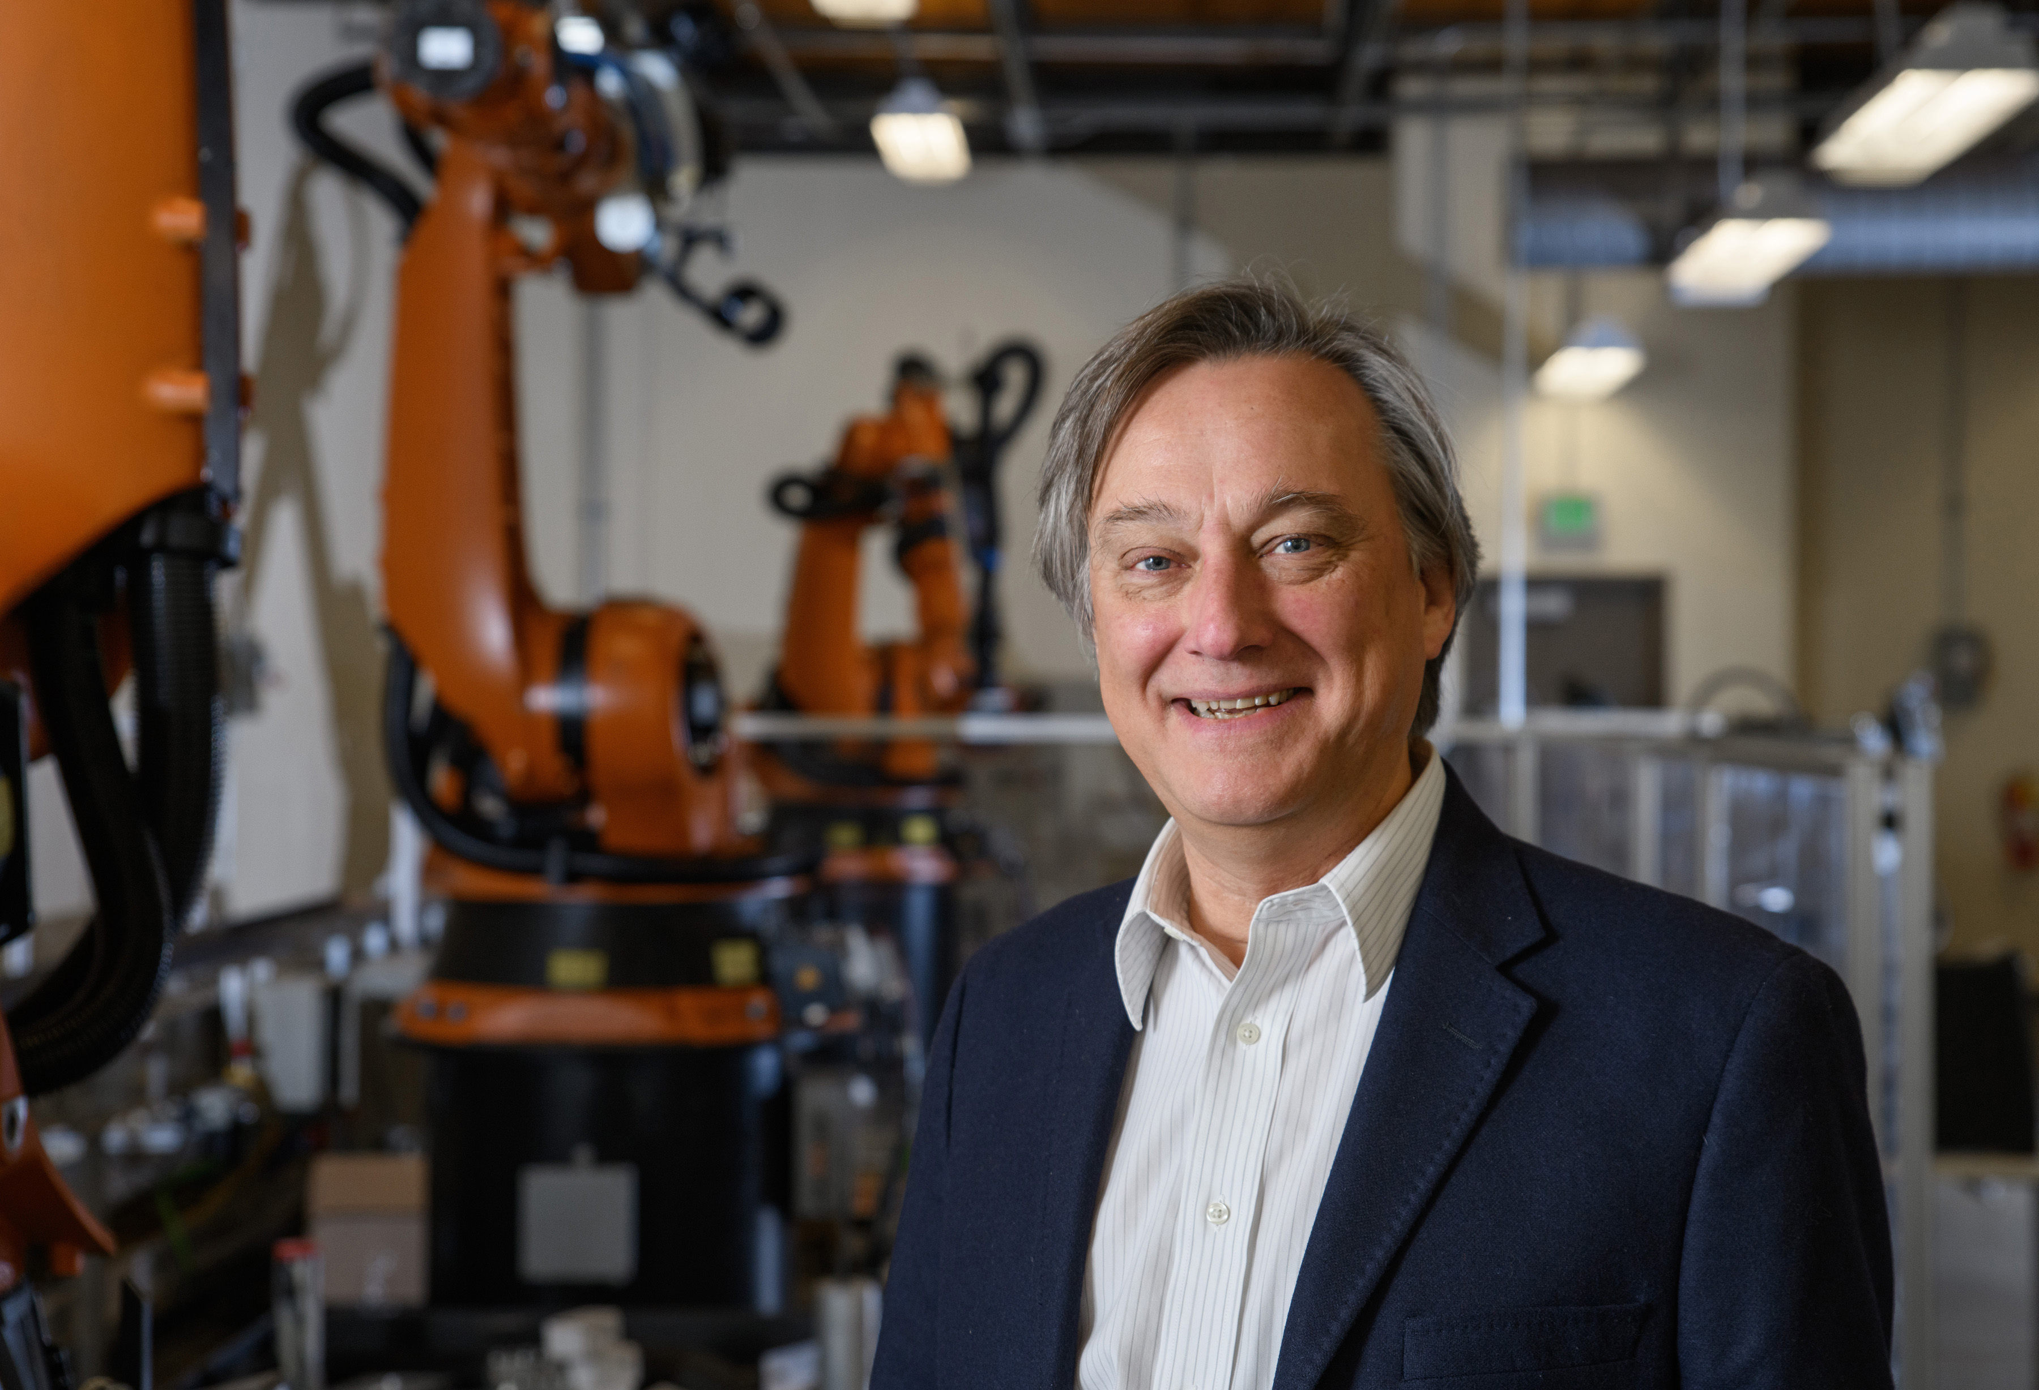
Course Instructors
Frank Dellaert, Professor
School of Interactive Computing
Seth Hutchinson, Professor
School of Interactive Computing
TAs: Binit Shah, Yetong Zhang, Rachit Bhargava, Dashiel Heidt, Pratyusha Karnati, Maya Rajan, John Yi

Slide 3
Robots are useful!
Manufacturing
Logistics (inventory, warehouse logistics, packaging)
Transportation (self-driving cars)
Consumer and professional services (cleaning, mowing)
Health, independence and quality of life (exoskeletons, semi-autonomous wheelchairs)
Agriculture

Slide 4
Robot Taxonomy
Industrial Robots
Service Robots
Field Robots
Humanoid Robots
Medical Robots
Self-Driving Cars
Aerial Vehicles
http://www.kuka.com

Slide 5
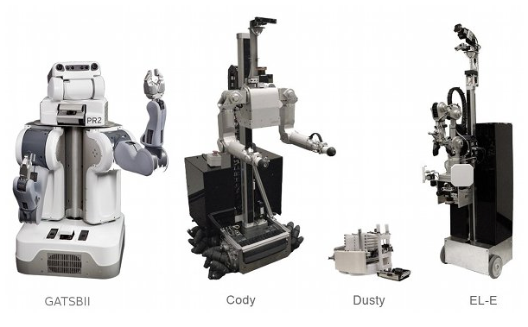
Robot Taxonomy
Industrial Robots
Service Robots
Field Robots
Humanoid Robots
Medical Robots
Self-Driving Cars
Aerial Vehicles

Slide 6
Robot Taxonomy
Industrial Robots
Service Robots
Field Robots
Humanoid Robots
Medical Robots
Self-Driving Cars
Aerial Vehicles
http://www.frc.ri.cmu.edu/robots/

Slide 7
Robot Taxonomy
Industrial Robots
Service Robots
Field Robots
Humanoid Robots
Medical Robots
Self-Driving Cars
Aerial Vehicles

Slide 8
Robot Taxonomy
Industrial Robots
Service Robots
Field Robots
Humanoid Robots
Medical Robots
Self-Driving Cars
Aerial Vehicles

Slide 9
Robot Taxonomy
Industrial Robots
Service Robots
Field Robots
Humanoid Robots
Medical Robots
Self-Driving Cars
Aerial Vehicles

Slide 10
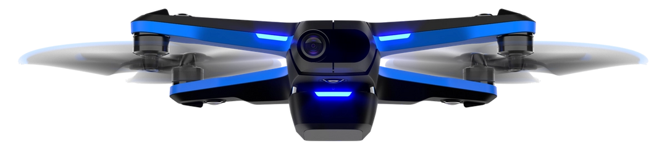
Robot Taxonomy
Industrial Robots
Service Robots
Field Robots
Humanoid Robots
Medical Robots
Self-Driving Cars
Aerial Vehicles

Slide 11
Schedule

Slide 12
5 Modules
Agents
Blind Duckiebot
Car + LIDAR
Seeing Duckiebot
Drone
Articulated Robots guest lecture

Slide 13
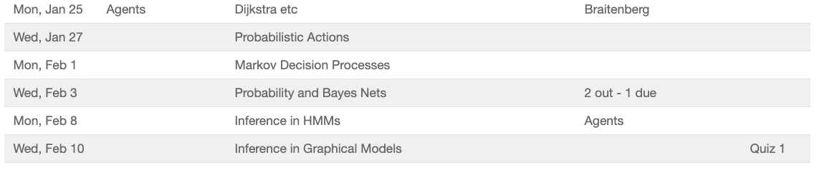
Agents

Slide 14
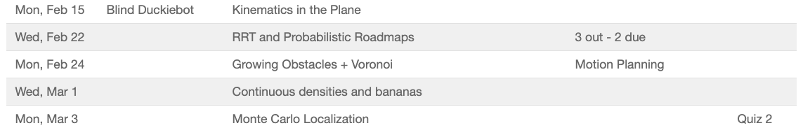
Blind Duckiebot

Slide 15
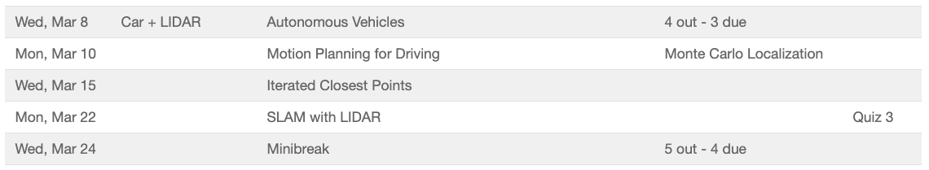
Car + LIDAR

Slide 16
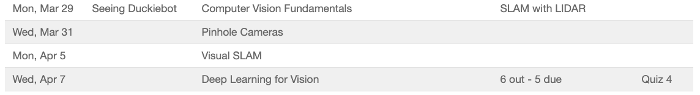
Seeing Duckiebot

Slide 17
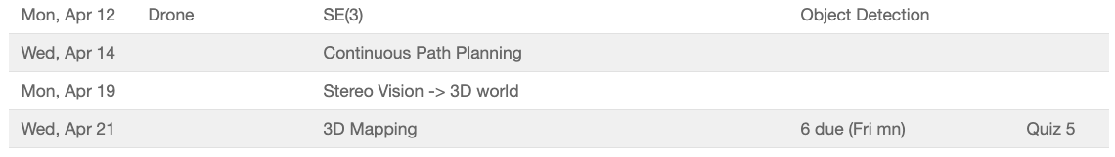
Drone

Slide 18
Syllabus

Slide 19
Learning Objectives
Describe and explain what robots are and what they can do
Describe mathematically the position and orientation of objects and how they move
Develop a control architecture for a mobile robotic system
Implement navigation and localization algorithms based on sensor fusion and environment representation
Write moderately involved programs in Python and Java to control a robotic system
Construct, program, and test the operation of a robotic system to perform a specified task

Slide 20
Prerequisites
The only formal prerequisite is CS1332 Data Structures & Algorithms.
Prior knowledge of fundamentals of linear algebra and probability is helpful, but not required.
Background in AI and Machine Learning is not assumed.
The course requires access to a computer.
All programming assignments will be completed in Python.

Slide 21
Lecture Delivery and Grading Components
Lectures will be pre-recorded and available 2 workdays before class time. Students are expected to watch the lecture before each class time.
Questionnaires: to reinforce the lecture and prepare for class time, the students will be required to answer a short questionnaire by Sunday evening about the two lectures assigned for viewing. This will count for 5% of your grade.
Quizzes: there will be 5 modules, as indicated on the schedule. At the end of each module, there will be an online quiz worth 6% of your grade each, for a total of 30%. Quizzes will have a combination of multiple choice and essay questions, as appropriate.
Q&A: students are expected to attend each class period, Monday and Wednesday at 3.30. Class will start with a 30 minute quick review and Q&A, followed by project-related activities (see below).
Activities: there will be six projects, each having an in-class activity component which forms an integral part of your participation grade, for a total of 5%. For these activities, you will be placed in groups that will remain stable for two projects, then shuffled.
Projects: each project will additionally have a powerpoint template that will have to be submitted on Gradescope as a pdf and, possibly accompanied with code and/or videos. Project are released and are due on Fridays, and project deliverables will make up 60% of your grade.

Slide 22
Academic Integrity
Academic dishonesty will not be tolerated. This includes cheating, lying about course matters, plagiarism, or helping others commit a violation of the Honor Code. Plagiarism includes reproducing the words of others without both the use of quotation marks and citation. Students are reminded of the obligations and expectations associated with the Georgia Tech Academic Honor Code and Student Code of Conduct, available online at www.honor.gatech.edu.
You are expected to implement the core components of each project on your own, but the extra credit opportunities often build on third party data sets or code. That’s fine. Feel free to include results built on other software, as long as you are clear in your hand-in that it is not your own work.
You should not view or edit anyone else’s code. You should not post code to Piazza, except for starter code / helper code that isn’t related to the core project.

Slide 23
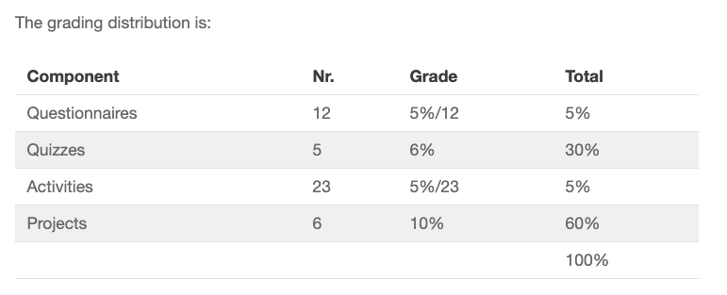
Grading

Slide 24
Questions?

